Slide 1

AdaptDiffuser:
Diffusion Models as Adaptive Self-evolving
张书涵

Slide 2
Diffusion
Model
Diffusion
Model
AdaptDiffuser
RL
Offline
RL

Slide 3
目录
Catalogue
1.
Diffusion Model & RL
2.
Diffusion Model for Planning
3.
AdaptDiffuser
4.
Improvement

Slide 4
01
Diffusion Model & RL

Slide 5
Generative Model
显式建模：朴素贝叶斯、隐马尔可夫链、
高斯混合模型、变分自编码器
生成模型：学习联合密度
P(x, y)
隐式建模：生成对抗网络、扩散模型
监督学习
判别模型：学习条件密度
P(y|x)

Slide 6
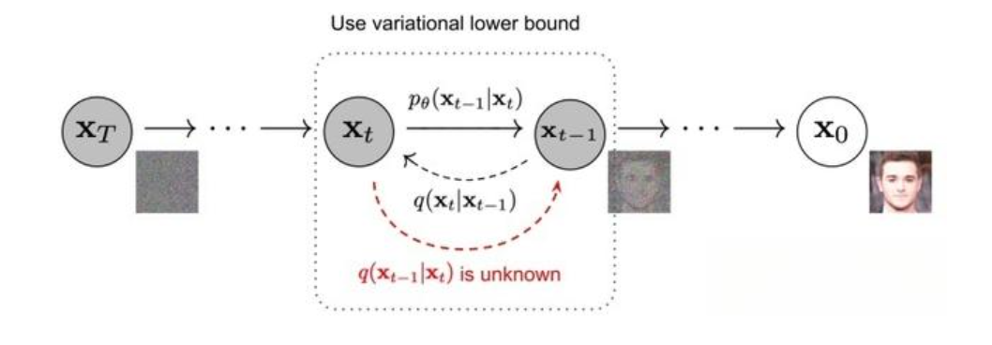
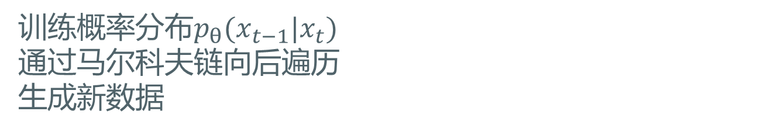
Diffusion Model
前向扩散
逆向扩散
训练概率分布$p_{θ}(x_{t−1}|x_{t})$
通过马尔科夫链向后遍历
生成新数据

Slide 7
RL
一个agent获取环境状态s，根据自身学习到的知识做出action反馈给环境，并得到一个奖励，不断迭代
状态s
奖赏γ
Agent
环境
四个基本要素
策略(Policy)：状态到行为的映射
奖励(Reward)：定义智能体表现好坏
价值(Value)：一段时间内收益
环境(模型)：对环境的模型
动作a
通过行为交互来学习一套策略
学习的数据是一系列轨迹
最大化累计奖赏期望

Slide 8
Planning
状态s
planning
环境已知：如何在已知model下进行规划
奖赏γ
Agent
环境
动作a
环境未知：对未知环境进行学习
learning

Slide 9
Offline RL
状态s
存在采样频率低的问题
奖赏γ
Agent
环境
动作a
离散强化学习(Offline RL)

Slide 10
02
Diffusion Model for Planning

Slide 11
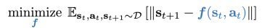
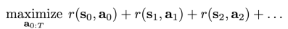
Planning as generative modeling
Replace prediction and planning with big generative model
1. Train a predictive model
2. Use model to evaluate potential plans $a_{0:T}$, selecting the best one

Slide 12
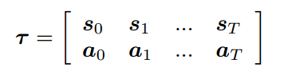
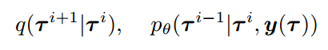
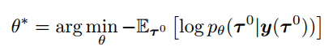
Diffusion Model for Trajectory Generation
Planning trajectory : sequence data with action as an additional dimension
Conditional diffusion process
Some special information of the given trajectory τ, such as:
The reward-to-go (return) the trajectory
Constraints must be satisfied by trajectory
Optimization objective
Distribution of trajectory

Slide 13
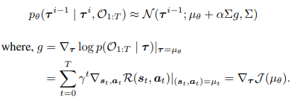
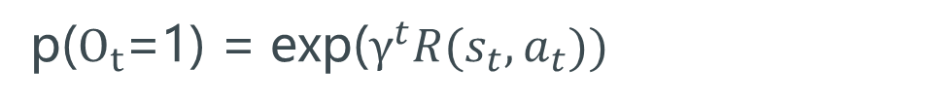
Diffusion Model for Trajectory Generation
Aim: maximize the reward-to-go
$O_{t}$：optimality of the trajectory at timestep t
~ Bernoulli distribution
p($O_{t}$=1) = exp($γ^{t}R(s_{t}, a_{t}))$
When$p(O_{1:T}|τ^{i})$ meets specific Lipschitz condition, we have :
Train dataset
Guidance from us

Slide 14
03
Adaptdiffuser

Slide 15
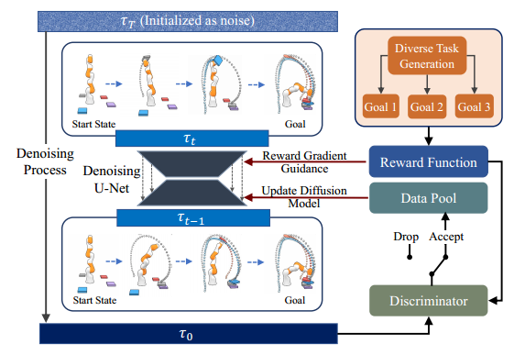

Self-evolved Planning with Diffusion
$$u_{θ}$$
离散数据池中数据多样性有限
Σ

Slide 16
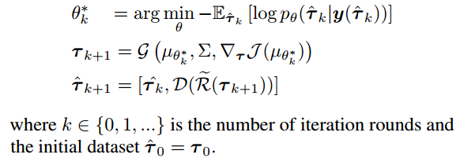
AdaptDiffuser Model

Slide 17
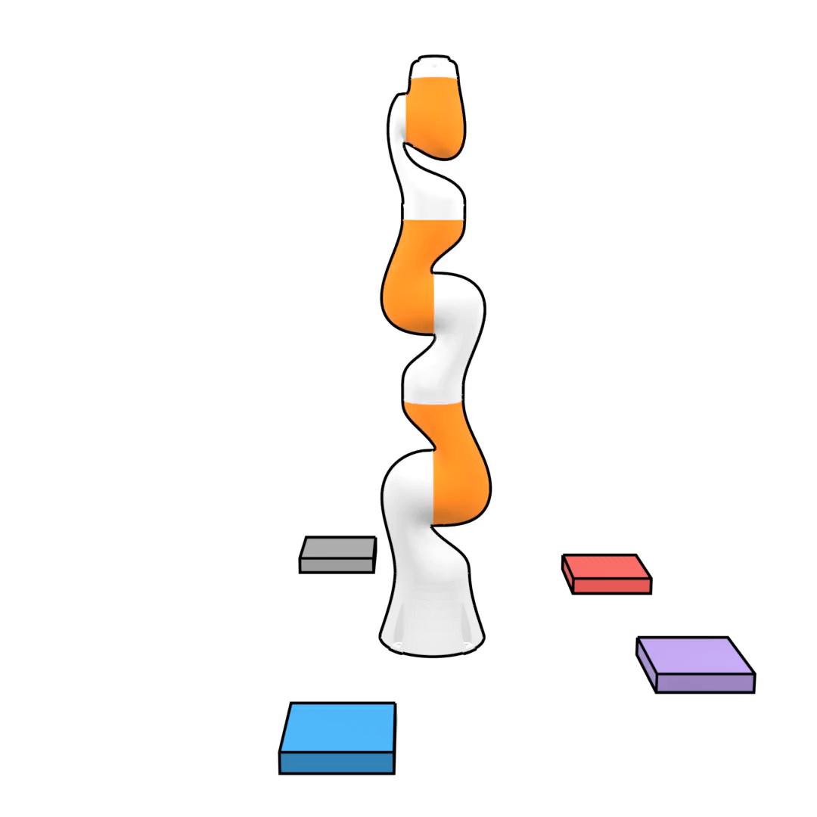
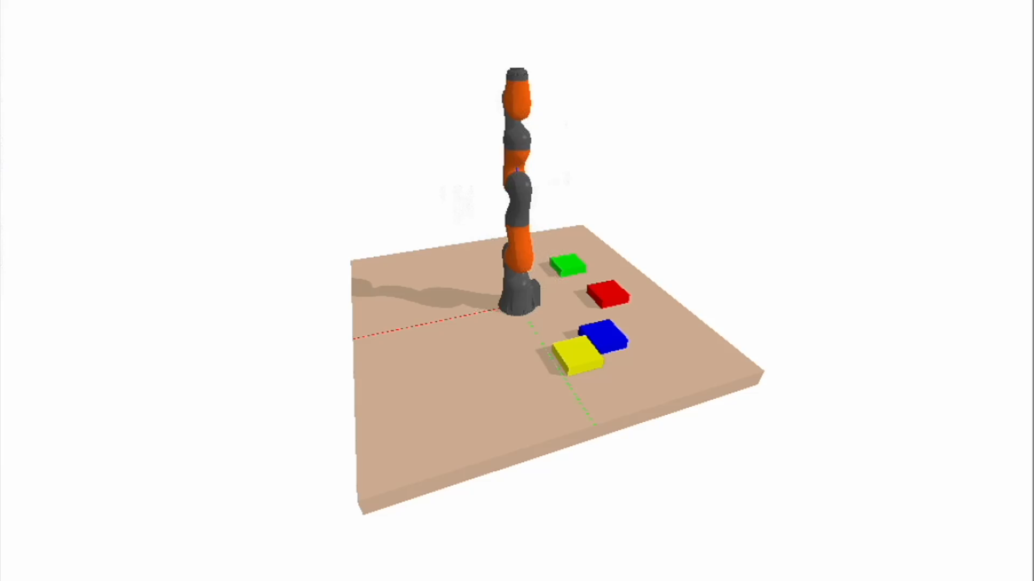
AdaptDiffuser Model

Slide 18
04
Improvement

Slide 19
Model-Based vs Model-Free
Problem 1:
High-dimensional observation space tasks
1. Convert data to a latent space (MLE)
2. Intelligent data sampling, select the samples which contribute more
Problem 2:
Increase the amount of computation required in training

Slide 20
Thank
You
Notes:
51PPT模板网 www.51pptmoban.com

Slide 21
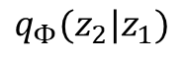
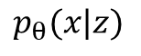
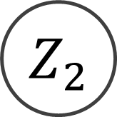
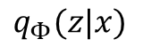
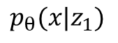
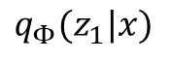
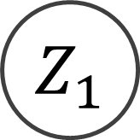
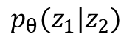
From VAE to Diffusion Model
VAE
Multi layers VAE
$$q_{Φ}(z|x)$$
$$q_{Φ}(z_{1}|x)$$
$$q_{Φ}(z_{2}|z_{1})$$
X
Z
X
$$Z_{1}$$
$$Z_{2}$$
$$p_{θ}(x|z)$$
$$p_{θ}(x|z_{1})$$
$$p_{θ}(z_{1}|z_{2})$$

Slide 22
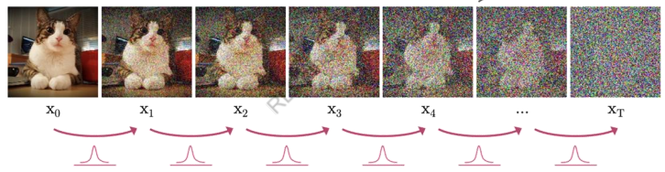
Diffusion Model
Forward diffusion process
Data
Noise
$$β_{t} values schedule is designed such that {\overline{α}}_{T}→0 and q\left(x_{T} | x_{0}\right)≈N(x_{T};0,I)$$

Slide 23
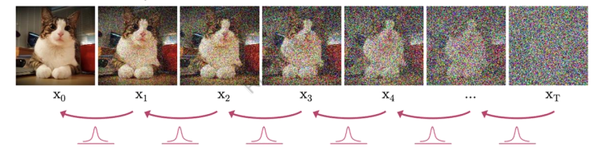
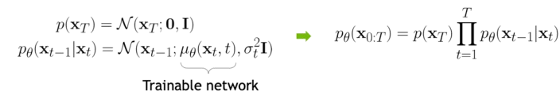
Diffusion Model
Reverse diffusion process
Data
Noise

